Slide 1
Verification of expected death
- The role of the nurse
3rd February 2017
Sue Parrott – Clinical Trainer

Slide 2

Notes:
What do they want to know? How much experience do they have?

Slide 3
Aims of the session
Explore professional and legal issues surrounding nurse initiated verification of expected death
Identify the stages of confirming death
What happens after someone dies
Notes:
AIM OF SESSION

Slide 4

Notes:
Quiz – in teams of mixed ability

Slide 5


Verification?
What?
Why?
When?
Who?
How?
Notes:
SO HAS THAT REASSURED YOU?

Slide 6

What does verification mean?
Confirmation of Death
That ALL signs of life are absent
Notes:
As against certification
See slide 16
To verify something is for the party wondering whether or not it is true to make a fair effort to determine its truth.
To certify something is to make an official pledge on behalf of oneself or on behalf of an organization where one is authorized to make such a pledge, that a particular thing is true.

Slide 7
Why is VOED by nurses necessary?
Unacceptable delays for relatives and carers in making further arrangements
Achievement of person's preferences
Delay in removal of medical devices
Increased use of nurses in management of long term conditions and end of life care
“Storage” issues
“Proceed without unnecessary and distressing delay”

Slide 8
When can a nurse verify death?
When the death is expected
  Medical responsibility to decide whether death is expected or anticipated
In accordance with LOCAL policy
Completed training & deemed competent
An “experienced” registered nurse?
Confident !

Slide 9
When not ………………
List as many situations that you can think of when a nurse CAN NOT verify the death of a person
Notes:
HRCH =
Sudden or unexpected death
Death within 24hrs of admission to a community hospital or discharge from hospital, if no clinical diagnosis has been made prior to a patient’s death
If expectation of death and ACP are not recorded
Paediatric deaths
As a result of a known untoward incident
Possible drug error
Unidentified person
Death post-operatively or post invasive procedure
Unexpected death but witnessed → CPR & help
Unexpected and un-witnessed → on call doctor
OTHERS =
Unexpected death
Unidentified person
Unclear or remotely suspicious
Within 7 days of surgical intervention (unless imminent death expected is recorded )
Untoward incidence
Negligence or malpractice
Not under obvious care
Police custody
16 or under
Accident or occupational risk
Hospice /community considerations
Industrial diseases
Death within 24 hours of admission/discharge
Fall within 24 hours

Slide 10
What is an expected death?
“Acute or chronic deterioration in a clients health status, or confirmation of an infection likely to exacerbate a client's existing medical condition, which has been documented by the Medical Practitioner within the last two weeks”
“A case where discussions have taken place between the medical and nursing team and the patient’s relatives and a decision has been made and documented that no further intervention is appropriate”

Slide 11
‘typical patient’
‘an expected death is when a patient is known to be suffering from a terminal illness, and there is no future plan for active intervention to prolong life’
NMC Advice (2008) Confirmation of Death
Following ACP discussion and documentation
DNACPR record indicating expected death

Slide 12
Unexpected death =
  ‘any death not due to a terminal illness or a death that the family were not expecting’
  ‘applies to patients where the medical practitioner has not attended with in the previous 14 days’

Slide 13
When must you NOT verify death?
Sudden or unexpected death
Death within 24hrs of admission to a community hospital or discharge from hospital, if no clinical diagnosis has been made prior to a patient’s death
If expectation of death and ACP are not recorded
Paediatric deaths
As a result of a known untoward incident
Possible drug error, negligence or malpractice
Unidentified person
Death post-operatively or post invasive procedure
Unexpected death but witnessed → CPR & help
Unexpected and un-witnessed → on call doctor
Remotely suspicious
Notes:
According to policy

Slide 14

What does the NMC say?
  Accountable
  Competent
What if you have ANY concerns AT ALL?

Slide 15
The NMC (2004) states:
“ A nurse cannot legally certify death as this is one of the few activities that the law requires to be performed by registered medical practitioners. The nurse may however confirm death has occurred, providing there is an explicit policy in place to allow such an action”
NB: This policy only applies to those patients whose death is anticipated, expected and predicted and where a clear not for resuscitation decision has been made and recorded

Slide 16
Verification v. certification
Verification confirms the FACT that someone has died
Certification confirms the CAUSE of the death

Slide 17
A “suitably” trained nurse therefore can…
Verify death
Notify relatives
Arrange & carry out last offices OR care after death
Arrange for the removal of the body to the mortuary

Slide 18
English law
Deciding whether life is extinct does not require a medically registered practitioner
Doctor must certify cause of death but not the fact of death
Nurses can not certify death
Does not require a doctor to view body
Does require the doctor attending the deceased during the last illness to issue a certificate detailing cause of death
Notes:
Surprise about Dr viewing?

Slide 19
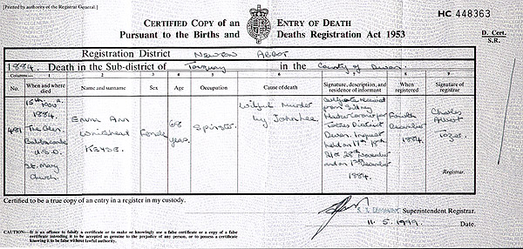
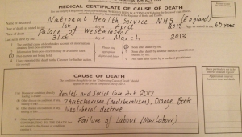
Medical certification of death
Issued by a doctor who has provided care in the last 14 days
Death should be certified within 24 hours or on next working day
Should be confident about the cause of death

Slide 20
Responsibility of attending Doctor
For burial
  Complete “medical certificate of cause of death”
  View body (?)
  Discuss case with nurse who has cared for the person
For cremation
  As above and in addition complete Cremation form
  Doctor to view body and complete Confirmatory Certificate Section
  2nd Doctor discusses and agrees cause of death
  Fee payable by family via Funeral Director
Notes:
£82 for cremation certificate

Slide 21
Proposed reforms
Aim for a unified system
Safeguards for burials as well as cremations
Appointment of local “medical examiners”
Not yet fully implemented……..

Slide 22

What could go wrong?
Person may appear dead!
Prolonged submersion in cold water
Following ingestion of alcohol or drugs
Hypoglycaemic
In a coma

Slide 23
Shipman Inquiry 2005
“You need to be very certain that the heart has really stopped, that it is not beating very, very slowly and very, very slightly. That respiration really has stopped and that you are not missing very slow, very shallow respirations”

Slide 24

Independent Newspaper
April 2007
“Embarrassed hospital officials have admitted they have no idea how a man was declared dead - and later discovered to be breathing. They have begun an investigation after mortuary staff, who came to collect the man, pointed out to staff he was still alive”.

Slide 25

Daily Mail Newspaper
January 2014
Man wakes up in mortuary more than 15 hours after hospital pronounced him dead
24-year-old man from central Kenya was rushed to hospital
He had drunk insecticide in an apparent suicide attempt
Pronounced dead, he was taken to the morgue to be embalmed
The anti-poison drugs may have made him appear to have died
Hospital is investigating how the mistake could have happened

Slide 26
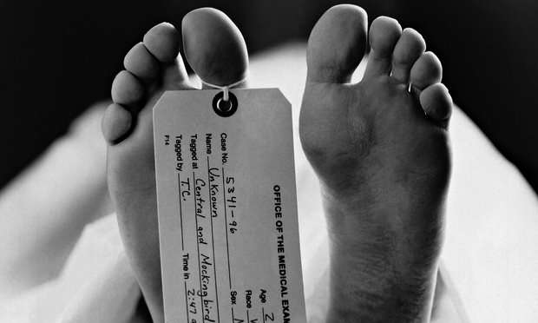
The Guardian Newspaper
November 2014
In Poland, a 91-year-old woman has shocked her family – and the public at large – by waking up in a morgue after being refrigerated having been declared dead. Despite 11 hours of cold storage, Janina Kolkiewicz was discovered to be alive and well after mortuary staff detected movements in her body bag.

Slide 27


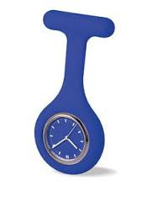

Tool kit to verify death – what do you need ?
Colleague – where possible
Stethoscope
Watch
Torch
Documentation

Slide 28
Physiological signs of death – absence of life
Absence of carotid pulse - 1 minute
Absence of heart sounds – minimum 1 minute
Absence of respirations checked by listening with stethoscope and observation - minimum 1 minute
Both pupils fixed and dilated, not responsive to light
(No response to painful stimuli – 10 sec sternal rub?)
Repeat until satisfied…..

Slide 29
Recording
Advance care plan
DNACPR
Verification of death checklist
  Syringe pump medication record
  Witnessing colleague
Patient electronic record
Notes:
Local policy

Slide 30
Case……
Mr Jones has end stage heart failure. The GP has said that he feels Mr Jones is entering the last part of his life and has discussed this with the patient & his wife.
Mr Jones dies.
Before verifying his death, is there anything else you would want to know?
Julie is a community RN. She has been qualified for 4 years. She has read the trust policy and had a recent VOED update. She works nights & hasn’t met Mr Jones before.
If you were Julie, would you verify?

Slide 31
Case…...
Mrs Jones explains that the GP hadn’t seen Mr Jones for a few days.
Why is this important? Would you require any clarification?
Julie is asked by the GP to verify Mr Jones’ death.
Should she?
Julie listens for heart sounds, feels for a pulse but thinks she may have seen pupil reaction to light.
What should she do next?

Slide 32


Slide 33
Signs that someone will die in the near future ?
Notes:
Diagnosing dying form

Slide 34

Competency for nurses VOED
Local policy
Competency document

Slide 35
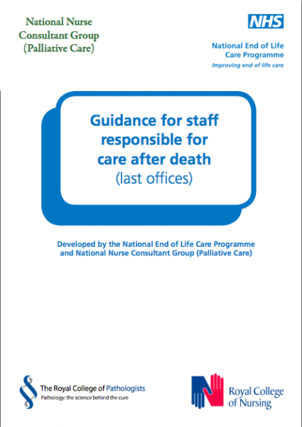
Care after death
Good end of life care doesn’t stop at the point of death
When someone dies all staff need to follow good practice which includes being responsive to family wishes
The support and care provided to relatives will help them cope with their loss

Slide 36
Care after death – ‘last offices’
Initially – laid flat with one pillow, minimal wash, limbs placed as straight as possible, clean nightwear/bedding
Following care after death – arms placed on top of abdomen, palms down
Removal or taping of rings & jewellery
Removal of urinary catheter
Dentures in place or collected by undertaker/porter
Washed
Do not shave
If needed dressing over orifices
Dress broken skin
Own or hospital nightwear
Brush hair
Notes:
Arm positions according to policy

Slide 37
Rigor mortis
(Latin meaning "stiffness of death")
Commences after about three to four hours
Maximum stiffness after 12 hours
Gradually dissipates until approximately 48 to 60 hours after death
Warm conditions can speed up the process of rigor mortis

Slide 38


Any questions?

